Slide 1
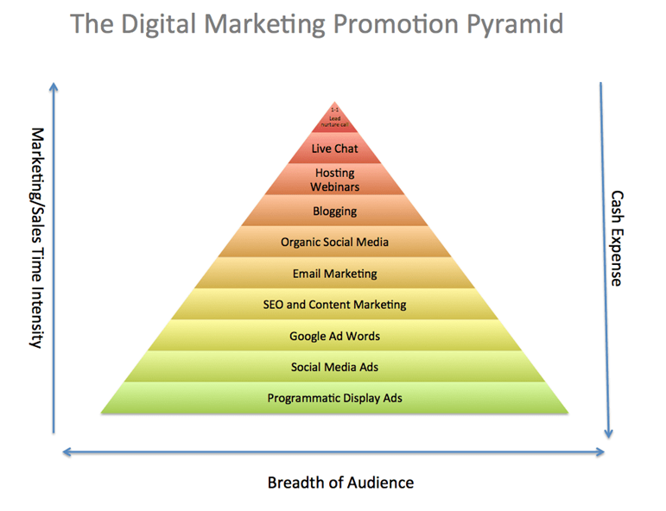
Promotion Strategy - Minja
In bound marketing – social media, content marketing, blogs and events.
This will target young people and social media users.
Push marketing- run ads on the TV and radio to create awareness about Ring Inc. to readers and educators.

Slide 2
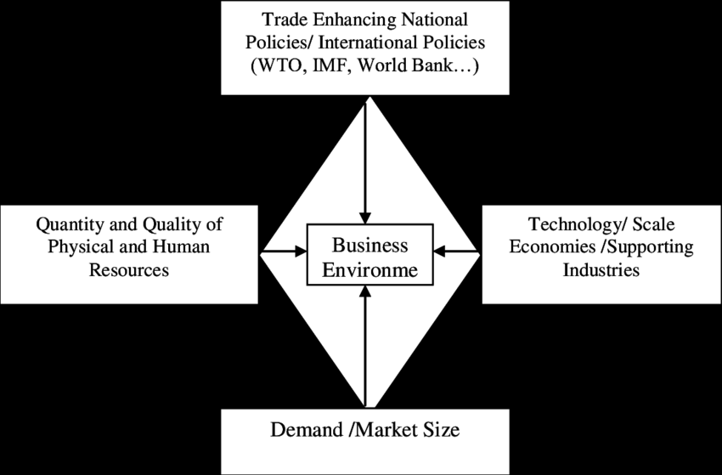
Comparative Advantages; Strategic Alliance; Business Opportunity - Minja
Ring Inc. will focus on getting higher relative prices and lower relative costs.
Through the unique value of its devices, it will target customers via a distinctive strategy.
Constant value chain analysis will enable Ring Inc. to offer irresistible prices.
The company will avail quality and rare devices to avoid pricing wars.

Slide 3
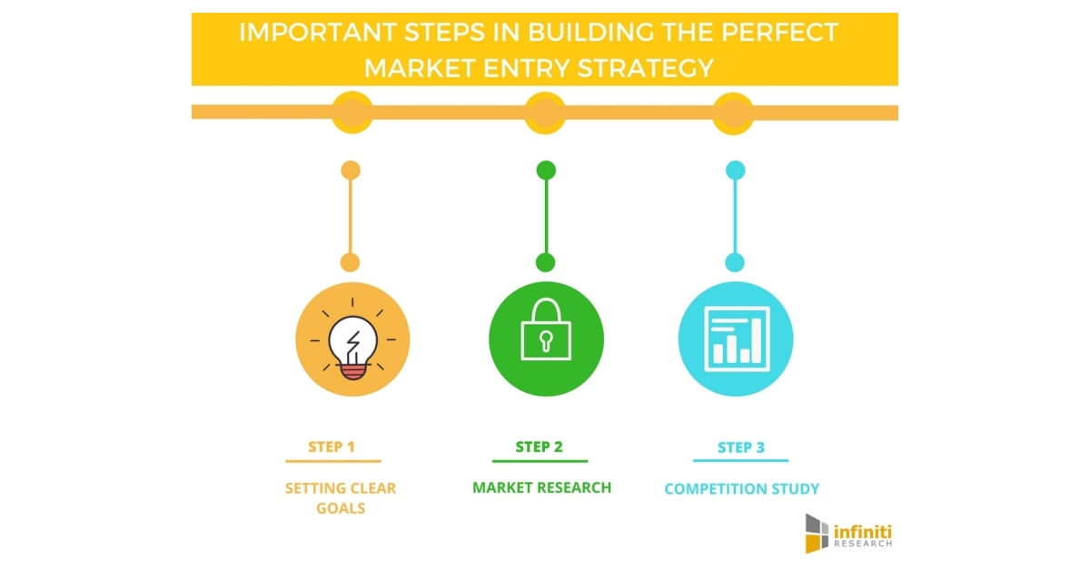
Initial entry
How to enter, with intermediaries and all needed information.
Sourcing will be done from the United States, and some local books.
Products support- labeling, packaging and specification will match Croatian culture.
Establishment of prices will consider local pricing strategies.
Agents will be trained to handle international customers.

